Slide 1
High Dimensional Analysis Merchandise Trading Company
Date | Dec 01, 2025
MCDA 5560
Bhavik Bhagat - A00494758
Miguel Palafox Gomez - A00494183
Md Chistia Chowdhury - A00485184
Notes:
1 – Maclean’s ranking visual
2 – Homecoming visual / multiple pictures perhaps on one slide or a few to flip through quickly
3 – Report to the Community Launch – Save the Date – November 7
4 –Advancement Report FY22 -- Highlights – 2-3 slides using screen shots from the attached report
1 – table of new awards established last year
1 – top 5 trending SMU stories in media last year
1 – top 5 stories on smu.ca last year

Slide 2

High Dimensional Analysis
Analyze Datasets
Large number of variables
Variables - Features, Dimensions
Occurs at the same time

Slide 3
Why database instead of a flat datasheet?
Understand complex relationship
Identify hidden patterns
Improve decision making
Reduce biasness
Require multi-level slicing
Manage hundreds of features of datasets

Slide 4
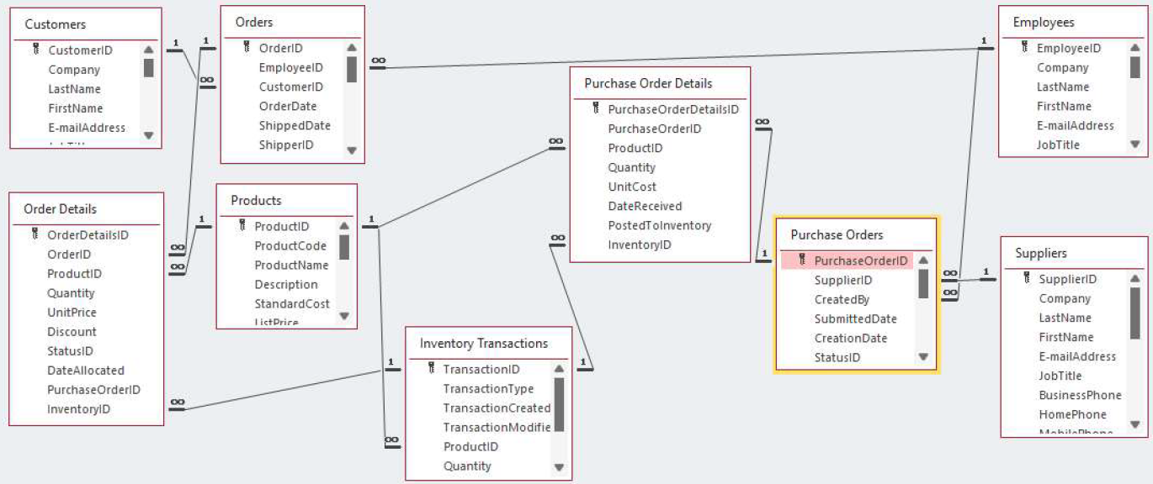
Entities and Relationships of the Sample Data

Slide 5
Data Cube
A Multi-Dimensional Data Structure
Used for Slicing, Dicing, Rolling Up, Drilling Down, Pivoting
A powerful way to store and analyze data across many dimensions at once, enabling fast, flexible business analytics.
Requires Dimensions, Facts(measures) and Hierarchies

Slide 6
Business Analytics Strategy
Identify top customers by quantity
Understand revenue dependence risk
Understand product portfolio revenue distribution
Answer the following question: How many units of product X was bought by customer Y on date Z? At what price?
Identify the most important suppliers
Identify suppliers that are selling us products above the average price
Answer the following question: How many units of product X was gotten from supplier Y on date Z? At what price?
Understand the relationship between quantity ordered from suppliers and unit cost

Slide 7
Customer Side

Slide 8
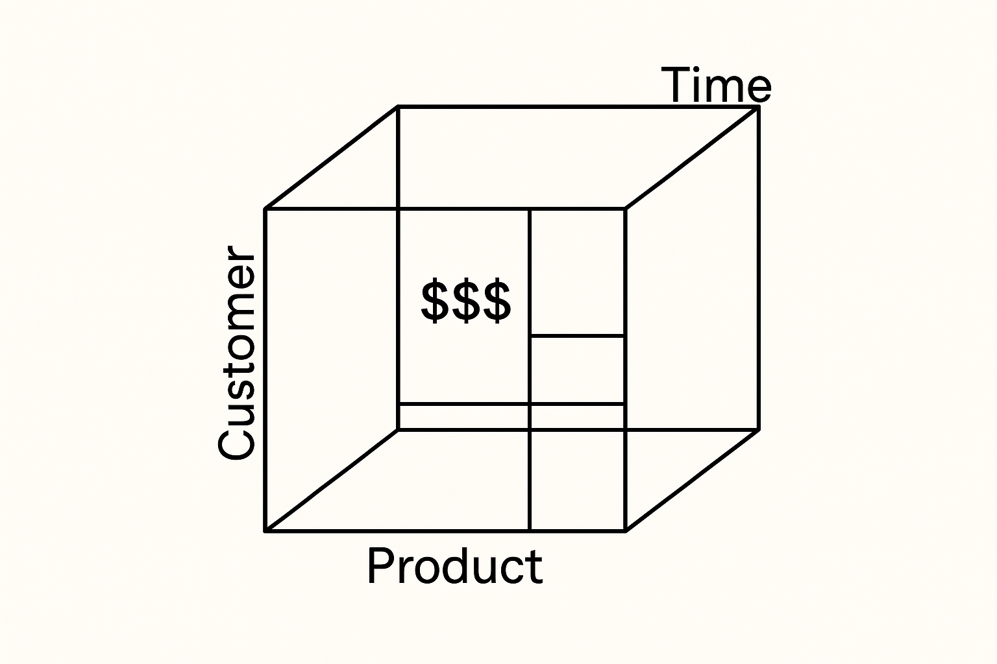
Data Cube
Demand Side
Dimension Tables: Customers, Products and Orders
Fact Table: Order Details
Dimensions: CustomerID, ProductID and OrderDate
Facts/Measures: Quantity and UnitPrice
Hierarchies: Geographical, Demographic, Product Category, Brand, Time etc
3D View of the Cube

Slide 9
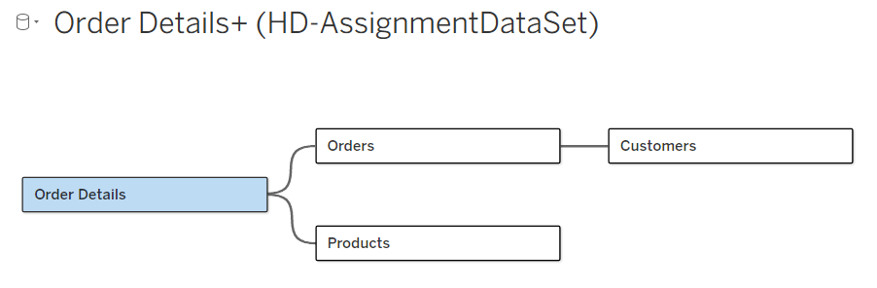

Slide 10
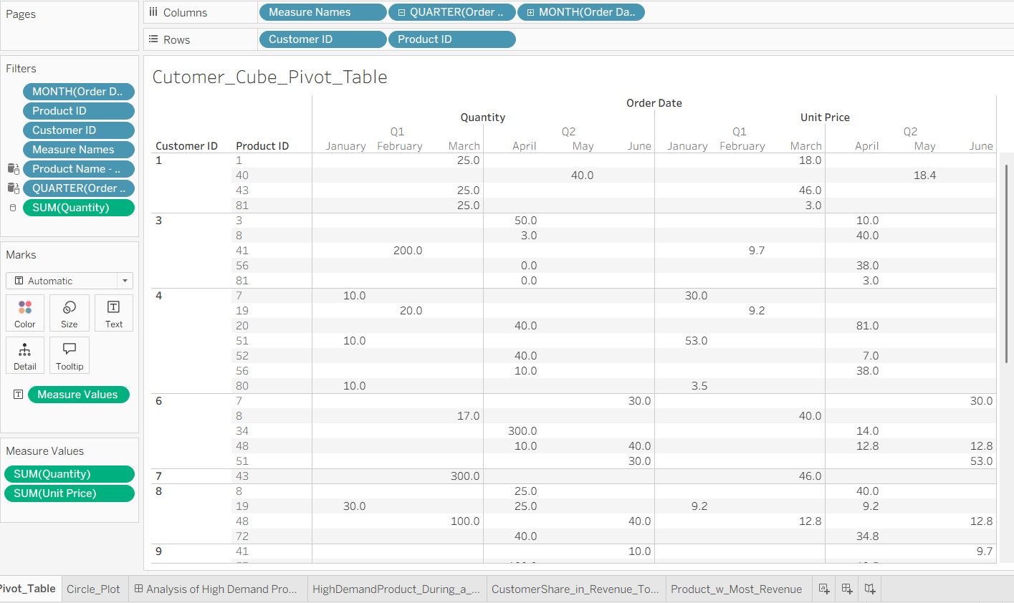

Slide 11
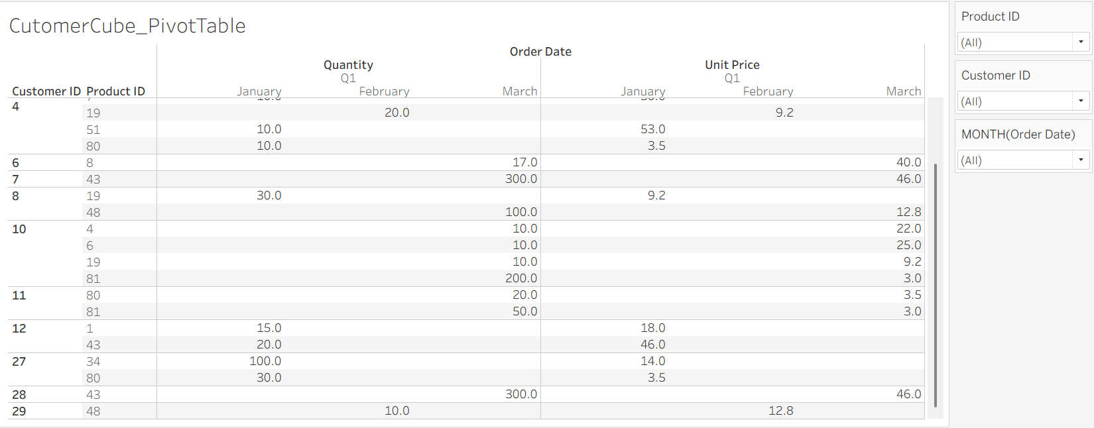

Slide 12
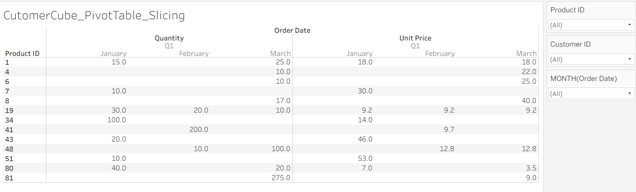

Slide 13
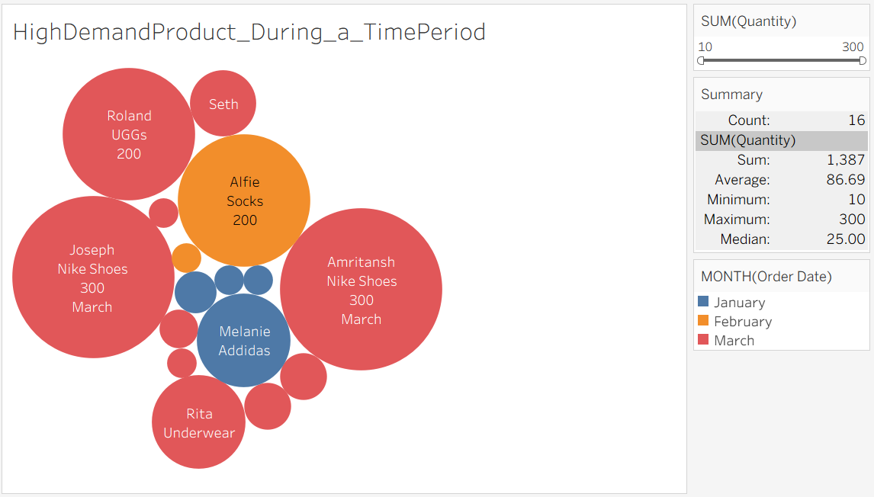
Bubble Visualization
We found out the top contributor customers who are buying product the most in a particular time so that we can give emphasis to the customer and product segment periodically.

Slide 14
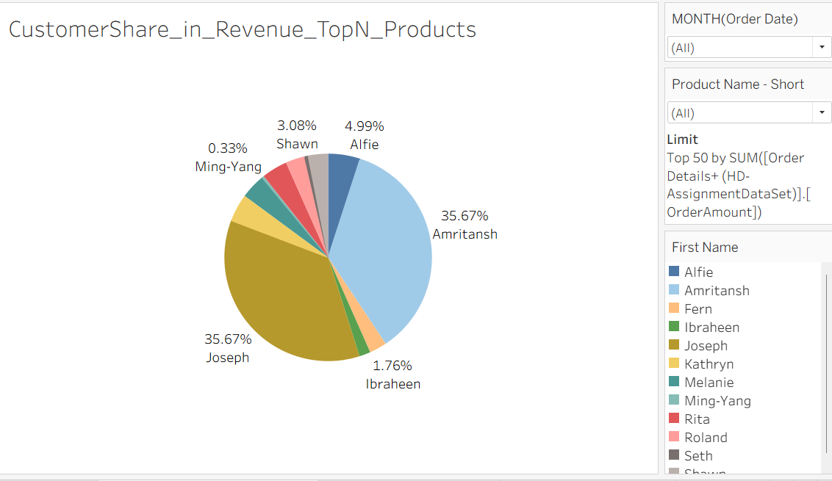
Pie Chart
We found out that the company has a high dependence on 2 customers that account for 71.34% of the revenue

Slide 15
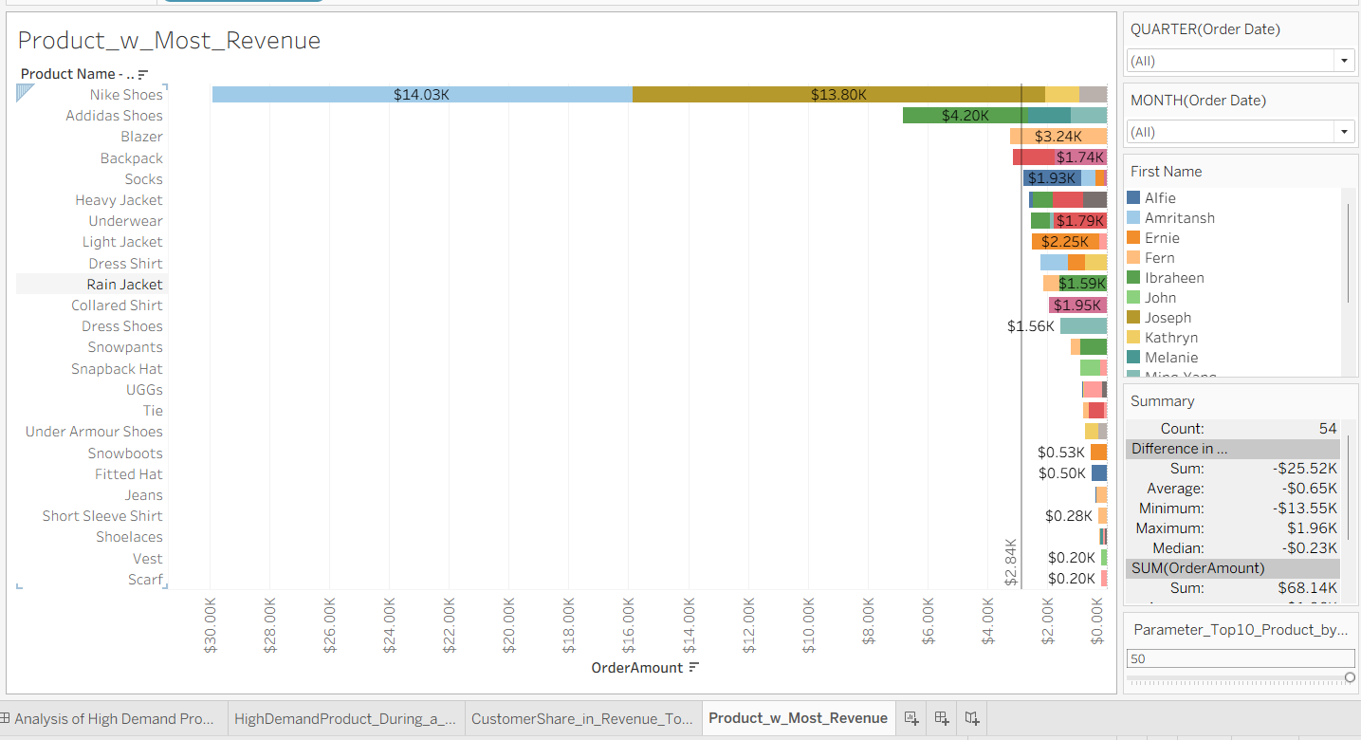
Notes:
Data Viz2: Product with Most revenue
The revenue is calculated based on Unit Price and Quantity. The parameter is created to get top N products based on revenue. This can be filered by Months or Quarters to get revenue for that month for a product.

Slide 16
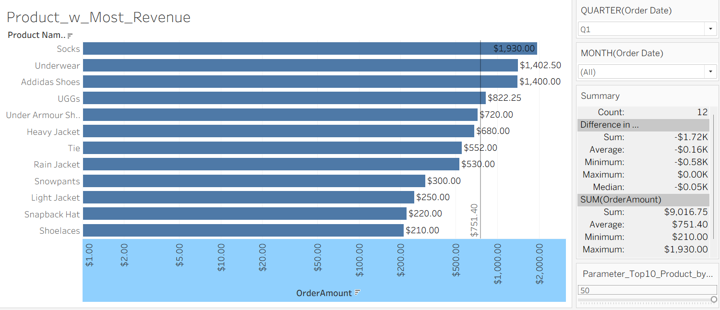
Bar Chart
The top selling products in a particular time to identify company’s strength in a product segment.

Slide 17
Supplier Side

Slide 18
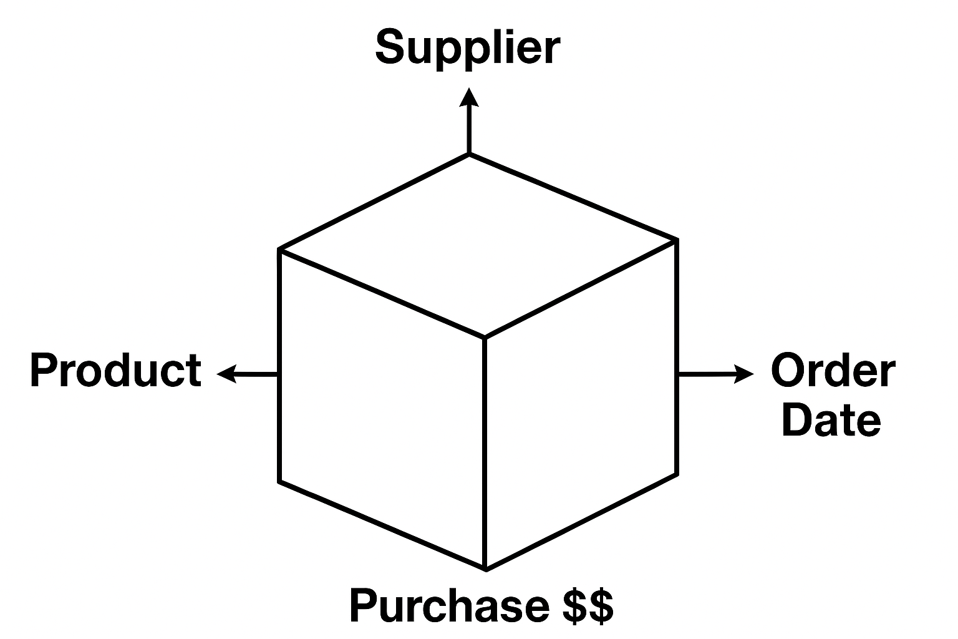
Data Cube
Purchasing Side
Dimension Tables: Suppliers, Products and Purchase Orders
Fact Table: Purchase Order Details
Dimension: SupplierID, ProductID, SubmittedDate
Facts/Measures: Quantity and UnitCost
Hierarchies: Geographical, Business, Product Category, Brand, Time etc
3D View of the Cube

Slide 19
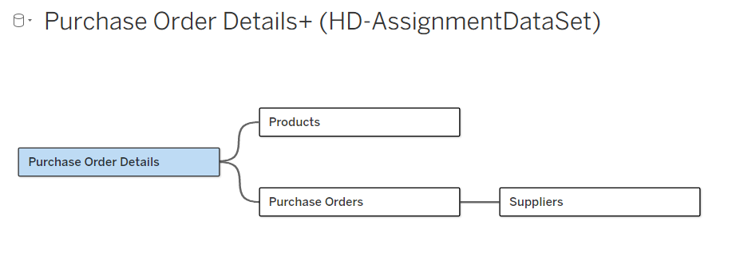

Slide 20
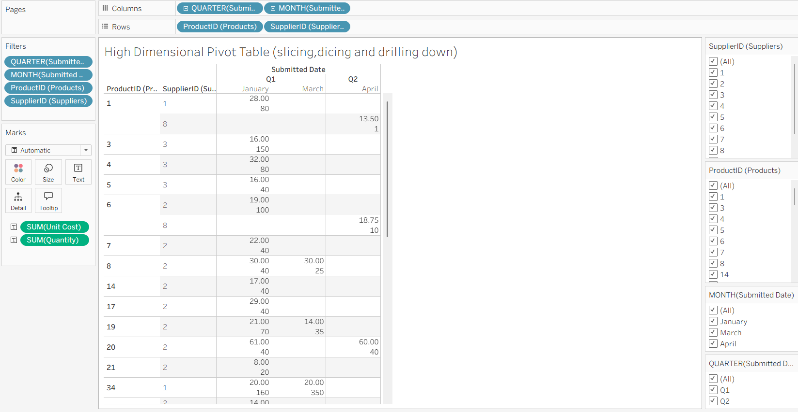
How many units of product X was gotten from supplier Y on date Z? At what price?
We ordered 61 units of product 20 from supplier 2 on January 2006 (Q1). Each unit was 40 dollars.

Slide 21
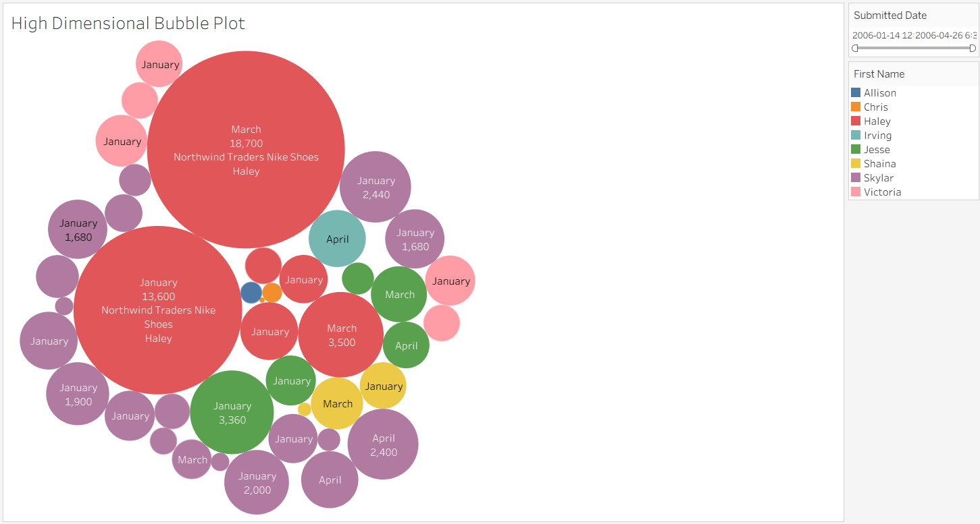
Most important suppliers across time
The Bubble visualization shows Total Cost (Quantity * UnitCost)
Haley and Skylar are the most important suppliers
Using colors, sizes, splits, and text we can represent many dimensions in a flat image

Slide 22
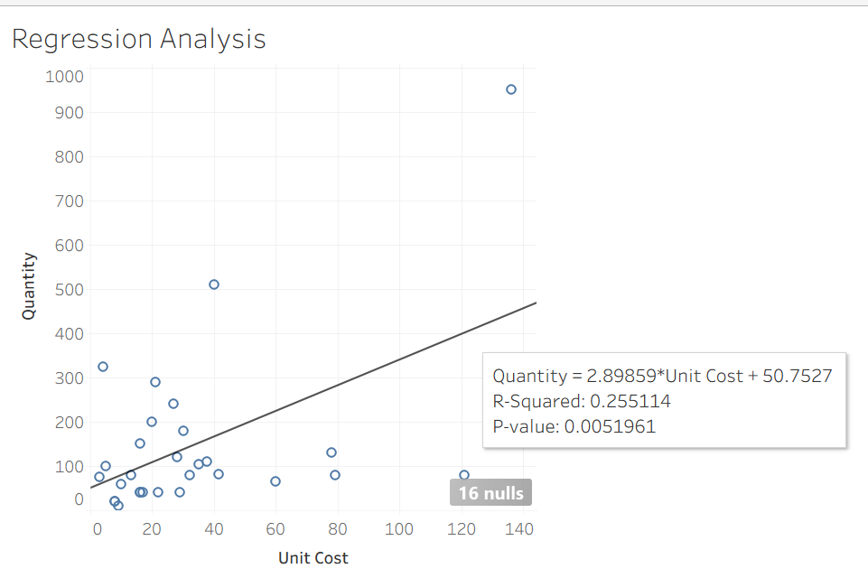
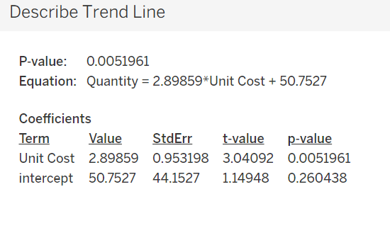
Statistical Analysis
There is a slight positive relationship between quantity and unit cost

Slide 23
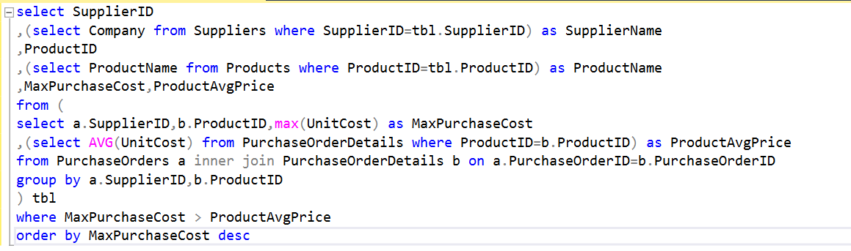
SQL Query
We discovered the suppliers who have provided us the products with a price which is greater than average price of those products. We should negotiate with them to reduce product cost.

Slide 24
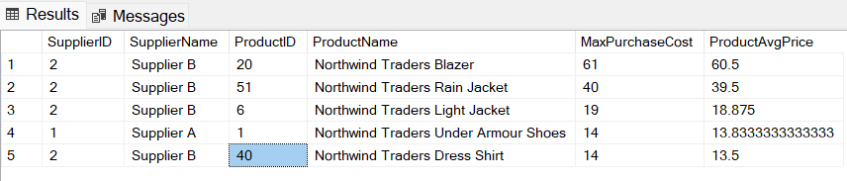
SQL Query
The result of the queries to find out the suppliers

Slide 25
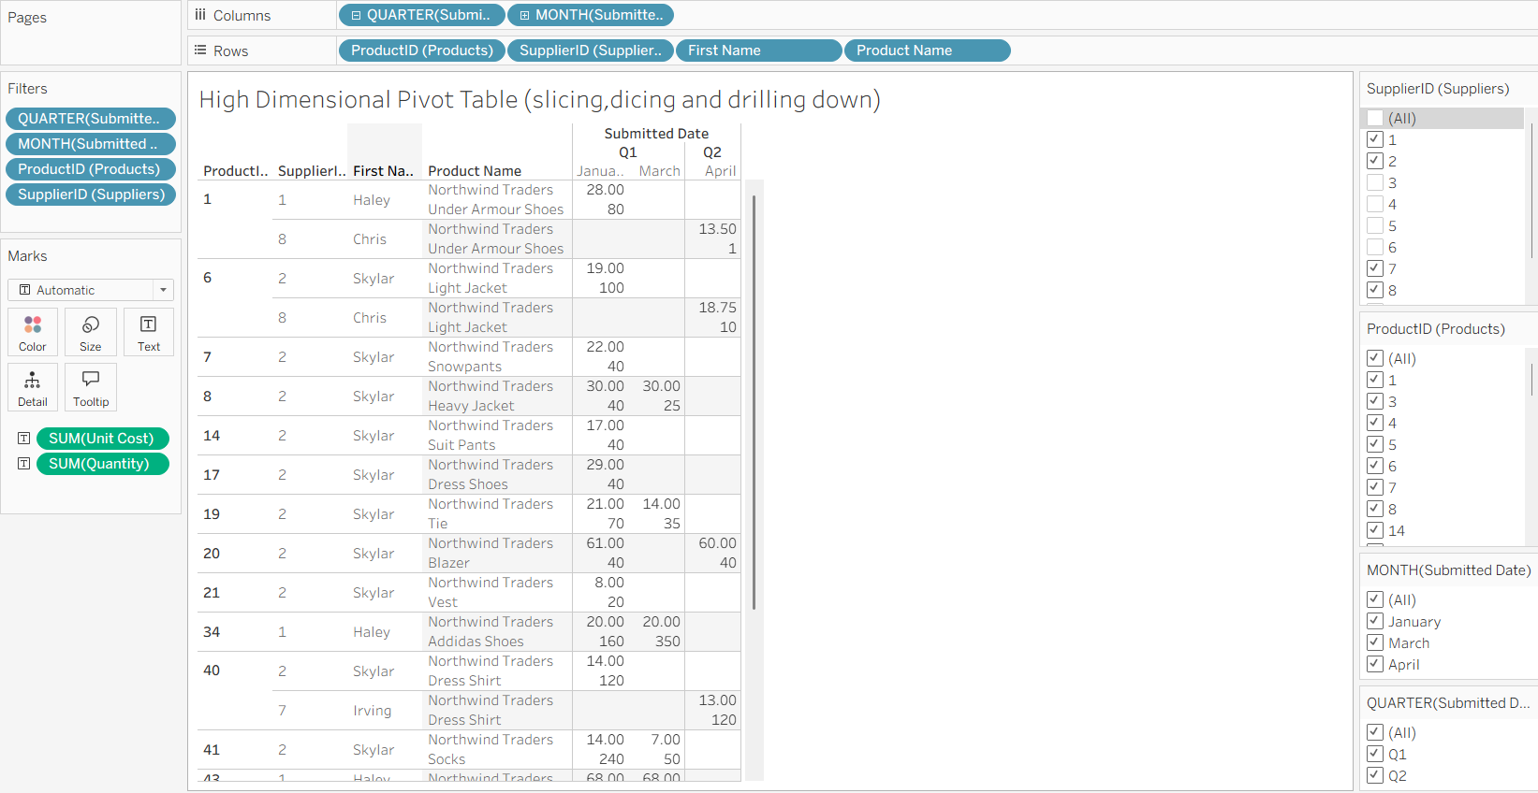
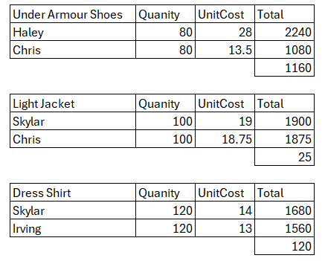
Savings

Slide 26
Stories summary
The company's revenue is highly dependent on 2 single customers, Joseph and Amritansh. There is a high risk for the company, those customers can have a lot negotiation power over the company and if they switch to another company, Merchandise Trading Company can go bankrupt. The company should try to diversify their sales among more customers.
The company spends most of the money on suppliers Haley (1) and Skylar (2), but they both are selling the products above average. The company should consider negotiating a lower price or buying more from other suppliers that offer the same products instead:
Under Armour Shoes from Chris (8) instead of Haley
Light Jacket from Chris instead of Skylar
Dress Shirt from Irving (7) instead of Skylar

Slide 27
Learning Reflection
Through building star/snowflake schemas that gave life to our data cubes, this assignment helped us understand how high dimensional data analysis can reveal insights that otherwise are hard to see. These insights can support crucial decisions.
Through building visualizations, queries, and statistical analysis, this assignment showed us how to take data-driven approaches to improve businesses process.

Slide 28

Questions
???

Slide 29

Thank You

